Slide 1
Exercises on Graphs

Slide 2
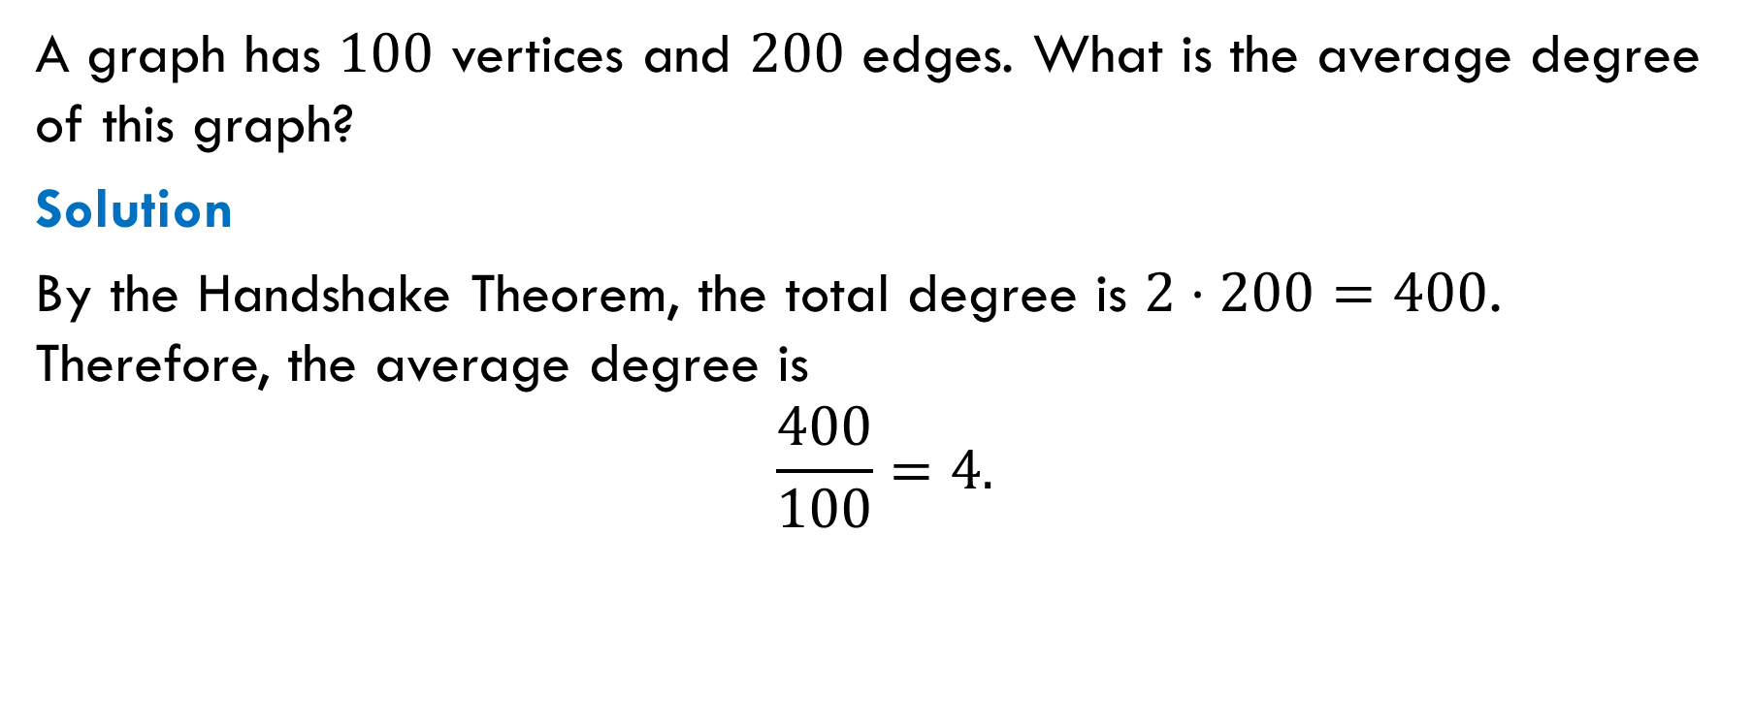
Exercise 1
A graph has $100$ vertices and $200$ edges. What is the average degree of this graph?
Solution
By the Handshake Theorem, the total degree is $2⋅200=400$. Therefore, the average degree is
$$\frac{400}{100}=4.$$

Slide 3
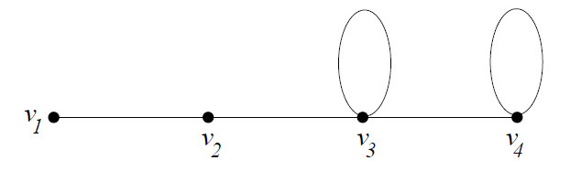

Exercise 2
Draw a graph with four vertices of degrees $1, 2, 3, 4$ (if it exists).
Solution

Slide 4

Exercise 3
Draw a graph with four vertices of degrees $1, 2, 3, 3$ (if it exists).
Solution
No such graph exists because its total degree is odd.

Slide 5
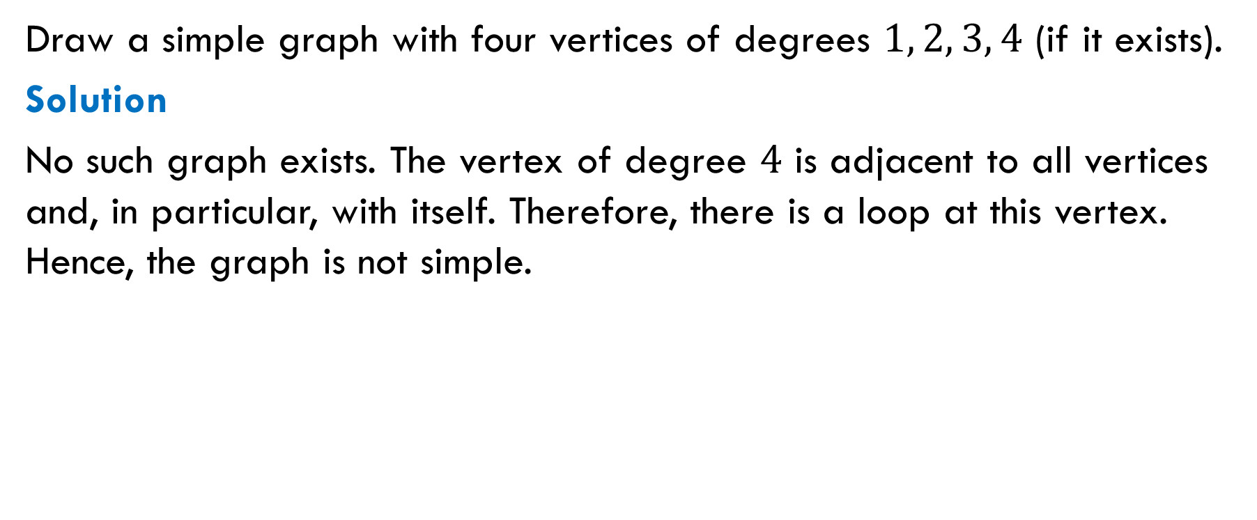
Exercise 4
Draw a simple graph with four vertices of degrees $1, 2, 3, 4$ (if it exists).
Solution
No such graph exists. The vertex of degree $4$ is adjacent to all vertices and, in particular, with itself. Therefore, there is a loop at this vertex. Hence, the graph is not simple.

Slide 6
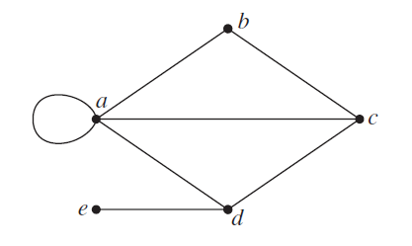
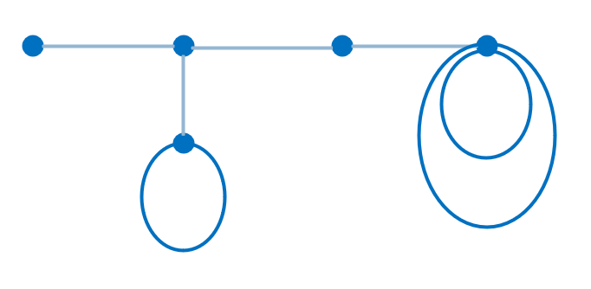

Exercise 5
Draw a graph with five vertices of degrees $1, 2, 3, 3, 5$ (if it exists).
Solutions

Slide 7

Exercise 6
How many edges does $K_{n}$ have?
Hint. Apply the Handshake Theorem.
Solution
$$\frac{n(n−1)}{2}$$

Slide 8
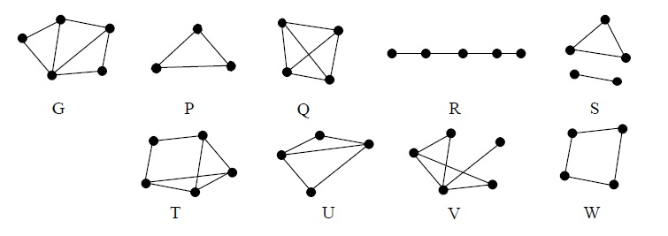
Exercise 7
Which of graphs $P$, $Q$, $…$ are subgraphs of graph $G$?
Answer: $P, R, S, U, W$are subgraphs of $G$.

Slide 9
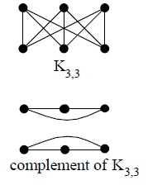
Exercise 8
Draw the complement of $K_{3,3}$.

Slide 10
Exercise 9
Is it true that every simple graph has at least two vertices of the same degree?
Solution. Yes, the statement is true. Here is a proof:
What are possible degrees in a graph with $n$ vertices? The maximum degree is $n−1$ since the graph is simple. Thus, the $n$ degrees are in the set $\{0, 1, 2, …, n−1\}$.
But a simple graph cannot have a vertex of degree $0$ together with a vertex of degree $n−1$. Therefore, the set of possible degrees has less than 𝑛 elements. By the Pigeonhole Principle, there are at least two vertices of the same degree.

Slide 11

Exercise 10
How many simple graphs with $5$ vertices are there?

